Slide 1
Microsoft Azure Certifications Explained
A Deep Dive for IT Professionals in 2020

Slide 2
1
Introductions
2
Barrier's and Struggles of Certification
3
Understanding Certification Tracks
Agenda
4
Training and Exam Costs
5
Learning Materials and Resources
6
Strategies for Lab Setup
7
Wrap-Up and Q & A

Slide 3

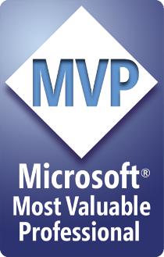
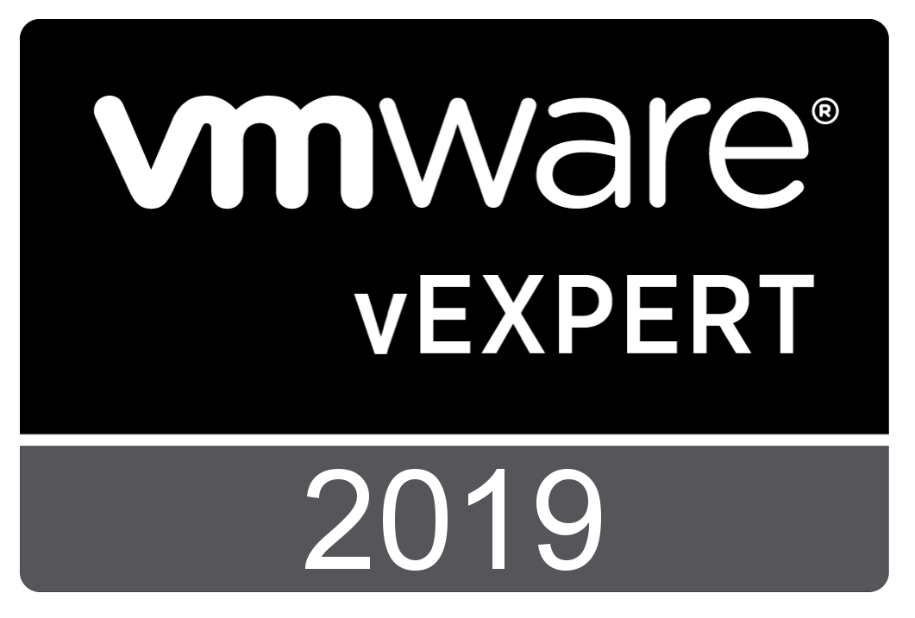


Meet your Host: Andy Syrewicze
Microsoft MVP (Cloud and Datacenter Management), VMware vExpert, & Technical Evangelist at Altaro
Technical Evangelist for Altaro Software
17+ Years providing technology solutions across several industry verticals
Historically have focused on the Windows Server Stack and VMware, with an emphasis on Hyper-V and vSphere Technologies
New Areas of Focus include Cloud and Containerization Technologies
@asyrewicze
www.altaro.com/hyper-v/ www.altaro.com/vmware/
www.altaro.com/msp-dojo/

Slide 4

About your Speaker: Luke Orellana
Technologist, Teacher of Things, and Community Leader
Author Evangelist at Pluralsight
20+ years of experience in the IT Pro Space
Works with technologies such as Exchange, VMware, Hyper-V, Azure, PowerShell, and Windows Server.
Main Focus: Automation, Infrastructure as Code, Azure, VMware, and Windows Server
@michaelbender
https://www.pluralsight.com/authors/michael-bender/
Notes:
Technical Evangelist for Altaro Software, providing community support, technical marketing and pre-sales expertise.
Prior to that I spent the last 14+ years providing technology solutions across several industry verticals including, education, fortune 500 manufacturing, healthcare and professional services working for MSPs and Internal IT Departments.
My focus has been in Virtualization, Cloud Services and the Microsoft Server Stack, with an emphasis on Hyper-V & VMware and interacting with the IT community via blogs, social media and published writings.

Slide 5

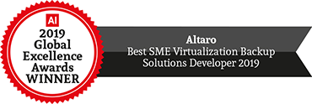

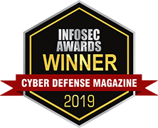
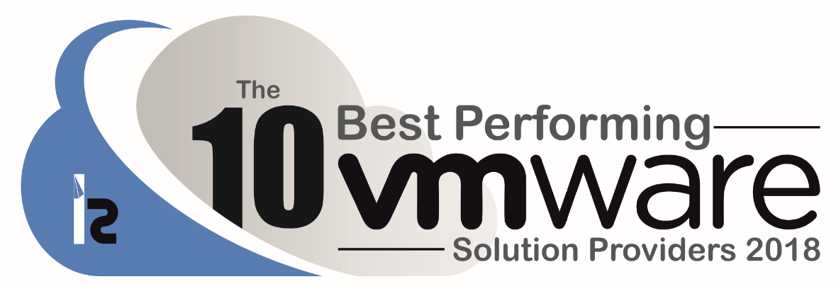
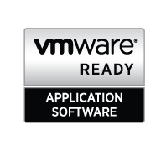

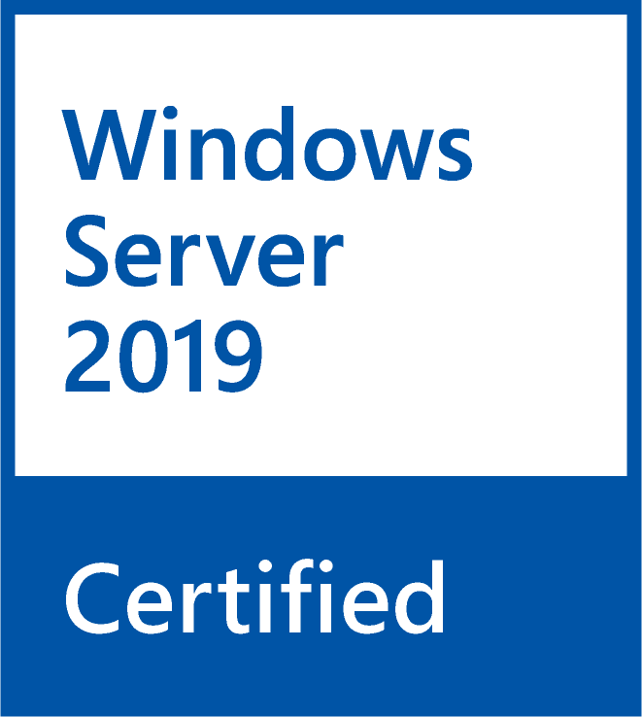
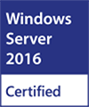
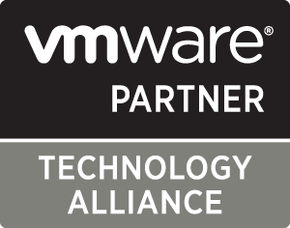
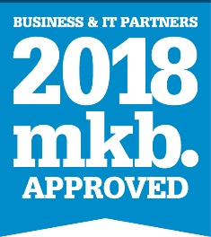



About Altaro Software
Altaro is a fast-growing developer of easy-to-use backup solutions for Managed Service Providers (MSPs), IT resellers and IT departments.
Virtual Backup trusted by 50,000+ Customers, 10,000+ Partners and 2,000+ MSPs worldwide.
Flagship product: Altaro VM Backup for Hyper-V and VMware – altaro.com/vm-backup
MSP program – altaro.com/msp

Slide 6
Barriers and Struggles of Certification

Slide 7

Poll & Discussion – What Are Your Barriers to Achieving Certification?

Slide 8
Understanding Azure Certification Tracks

Slide 9




Job Roles in the Cloud
Administrator
Developer
Solutions Architect
Security Engineer
Notes:
That is where the focus on job roles comes in.
Instead of just learning a single technology, a job role is a grouping of complimentary skill sets, that put together, allow you to perform much sought after jobs like Developing apps in Azure, architect solutions for Azure, and administering an Azure environment.
Today, organizations are looking for job roles that span technology stacks. For Instance, many companies looking for an Azure Administrator need someone who understands virtual machines, storage, networking along with platform as a service options like containers, web apps, and maybe software as a service components like Office365. Plus, they probably want some experience with coding like PowerShell, Python, or other languages. Not to mention Security. That is a lot of stuff to cover, but that is the changing world we live in.
For you to be successful in your career, you need to acquire the skills necessary for these sought after roles.
Transition to Demo: A great place to start are certifications for Microsoft Azure.

Slide 10
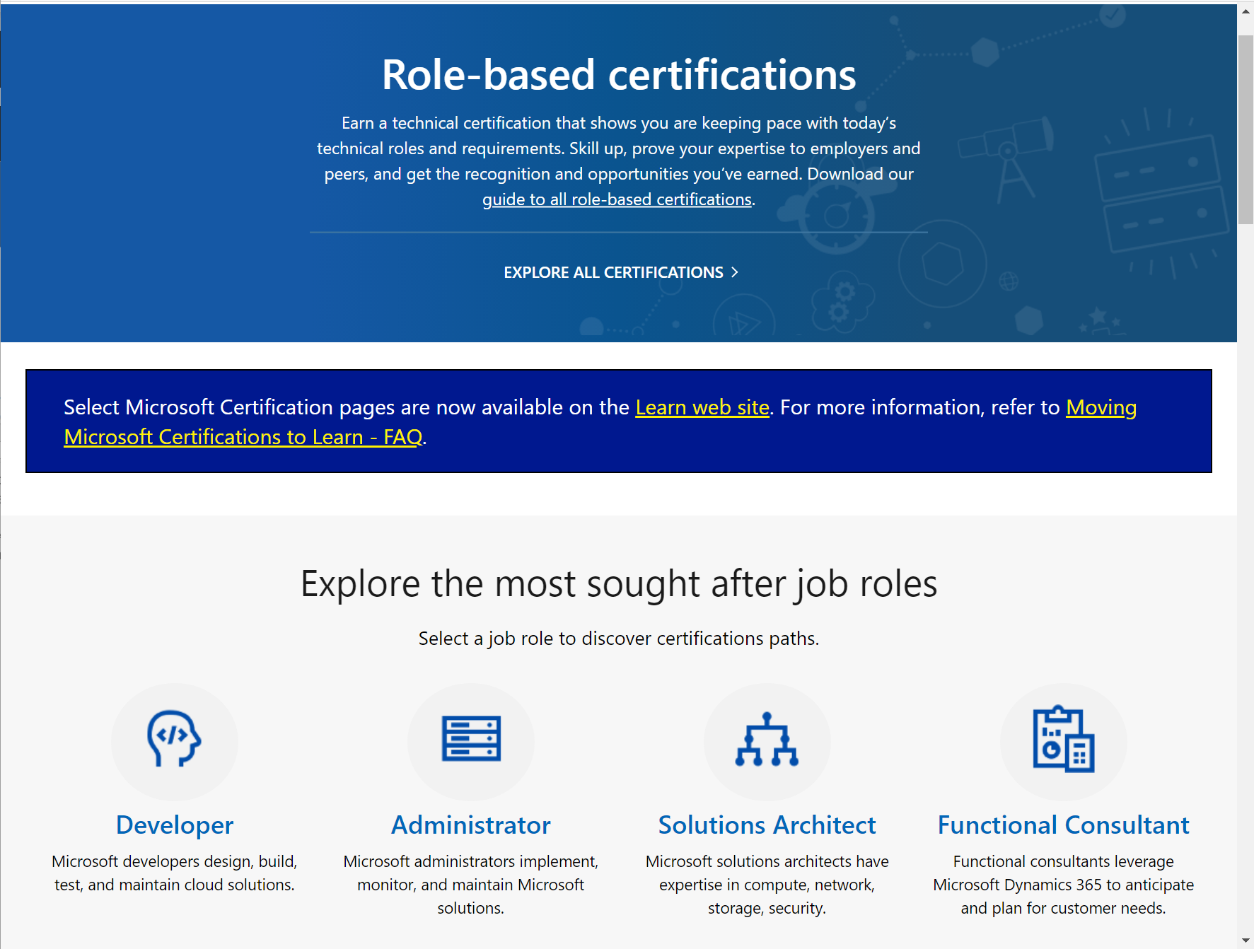
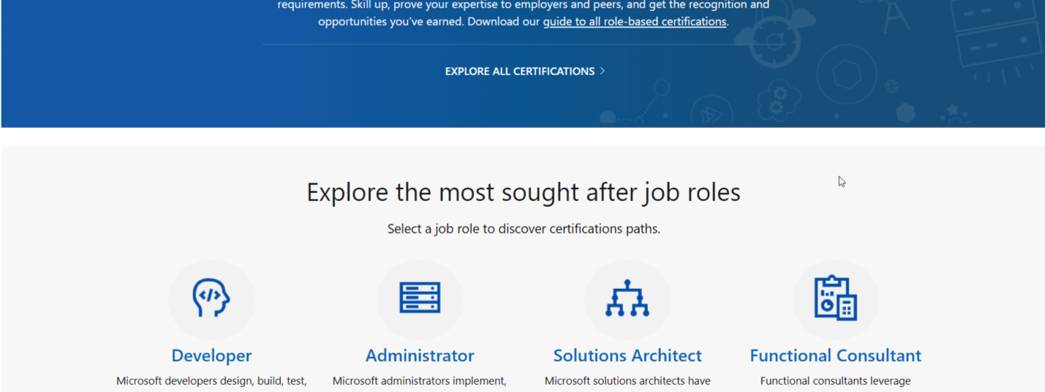
Microsoft Role-Based Certifications
Notes:
Fortunately, you have some help in the Azure world.
With Microsoft's updated certifications, all are role based and designed around in-demand job roles.
Riff on roles, cover top 4
Dive into Administrators
Slide 9 in PDF

Slide 11
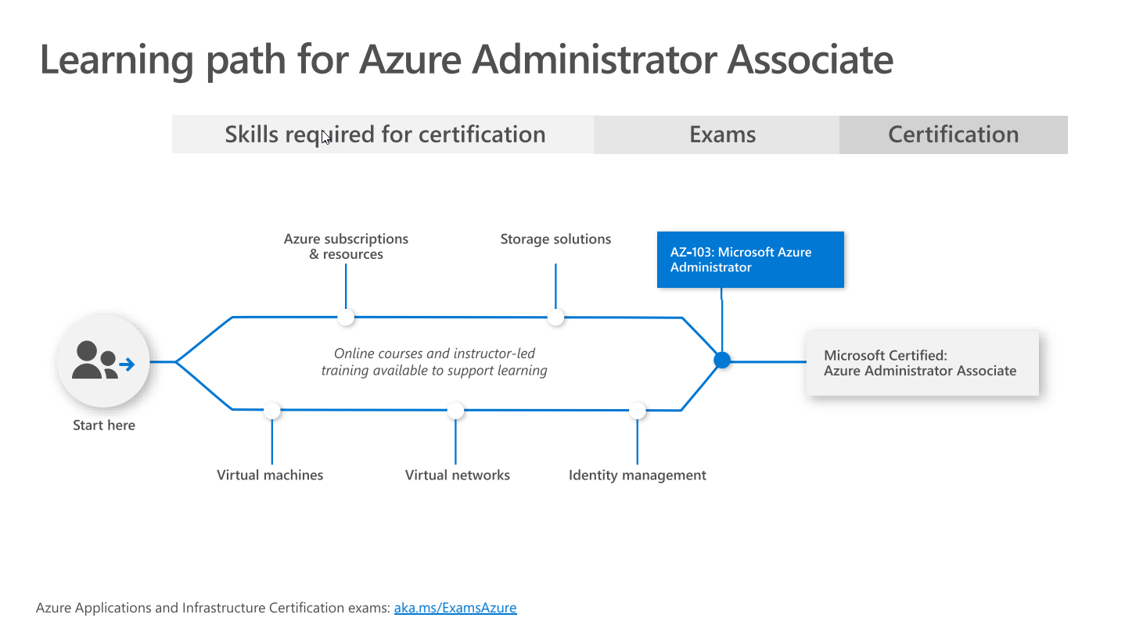
Notes:
Ref: https://query.prod.cms.rt.microsoft.com/cms/api/am/binary/RWtQJJ

Slide 12
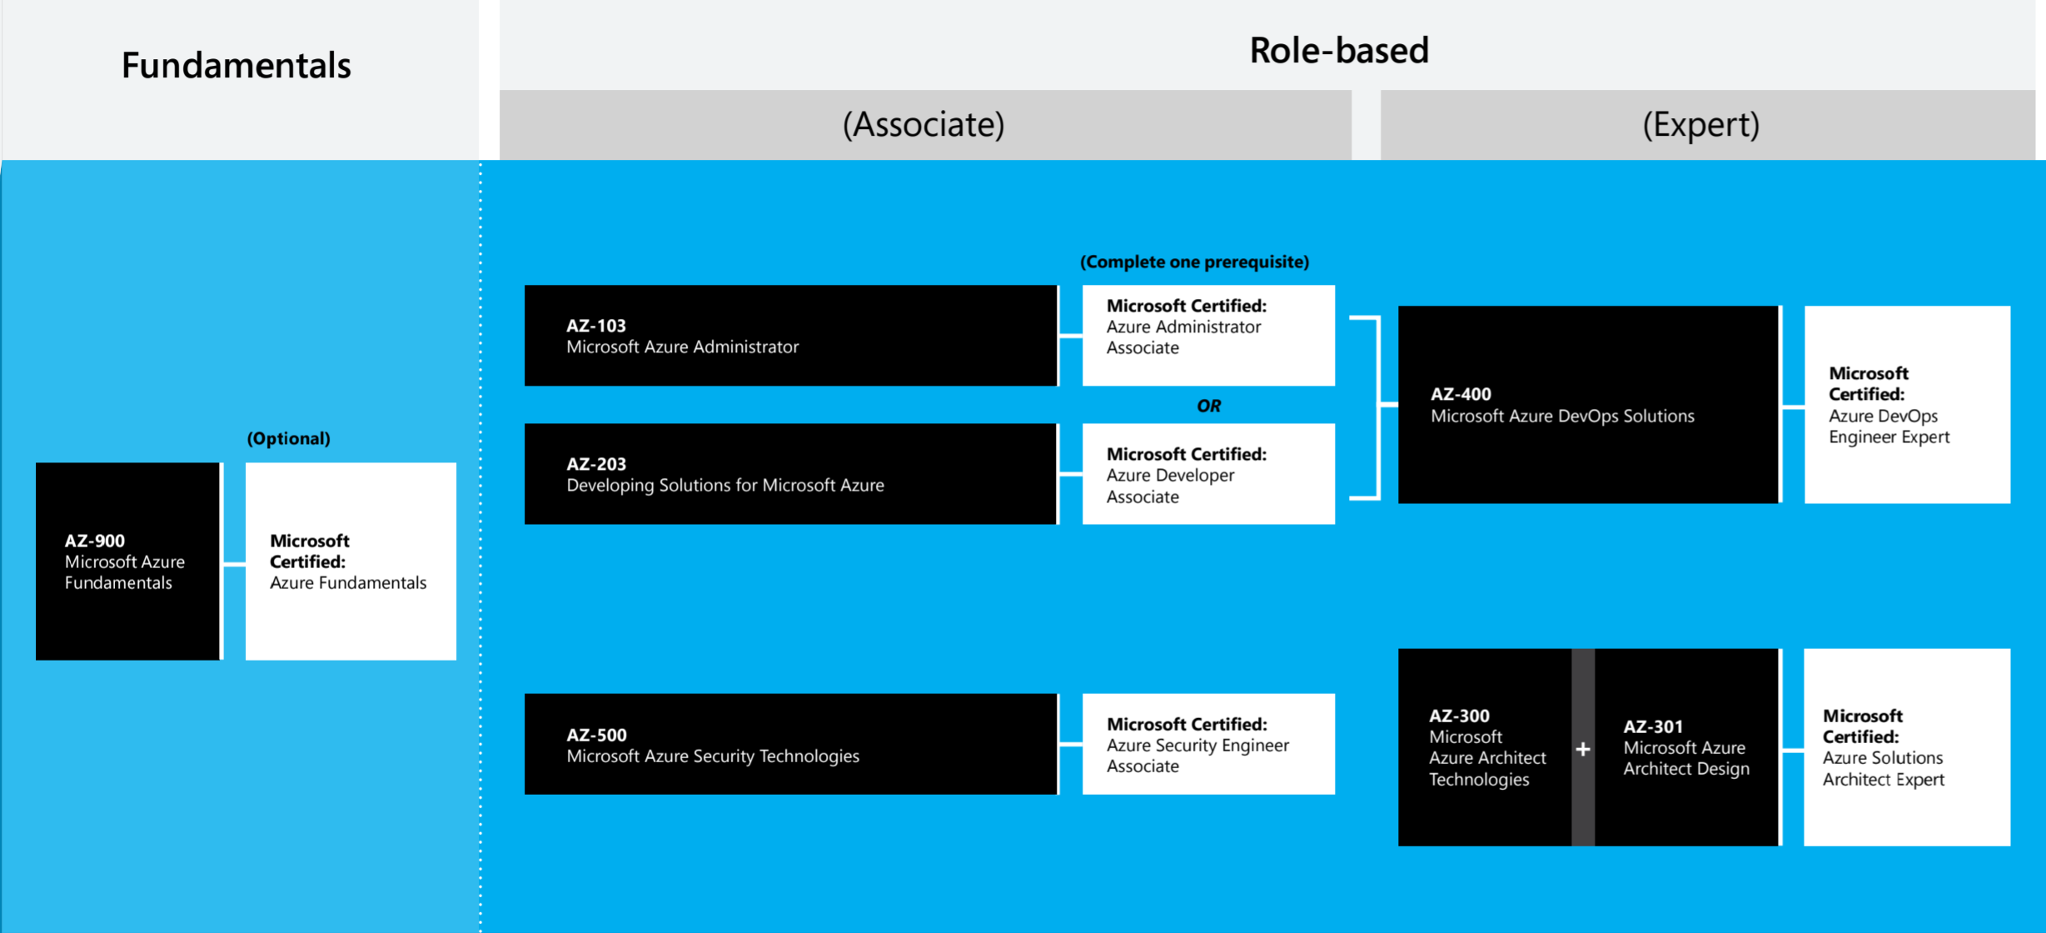
Azure Certification Path
Courtesy of Microsoft.com - https://aka.ms/TrainCertPoster

Slide 13
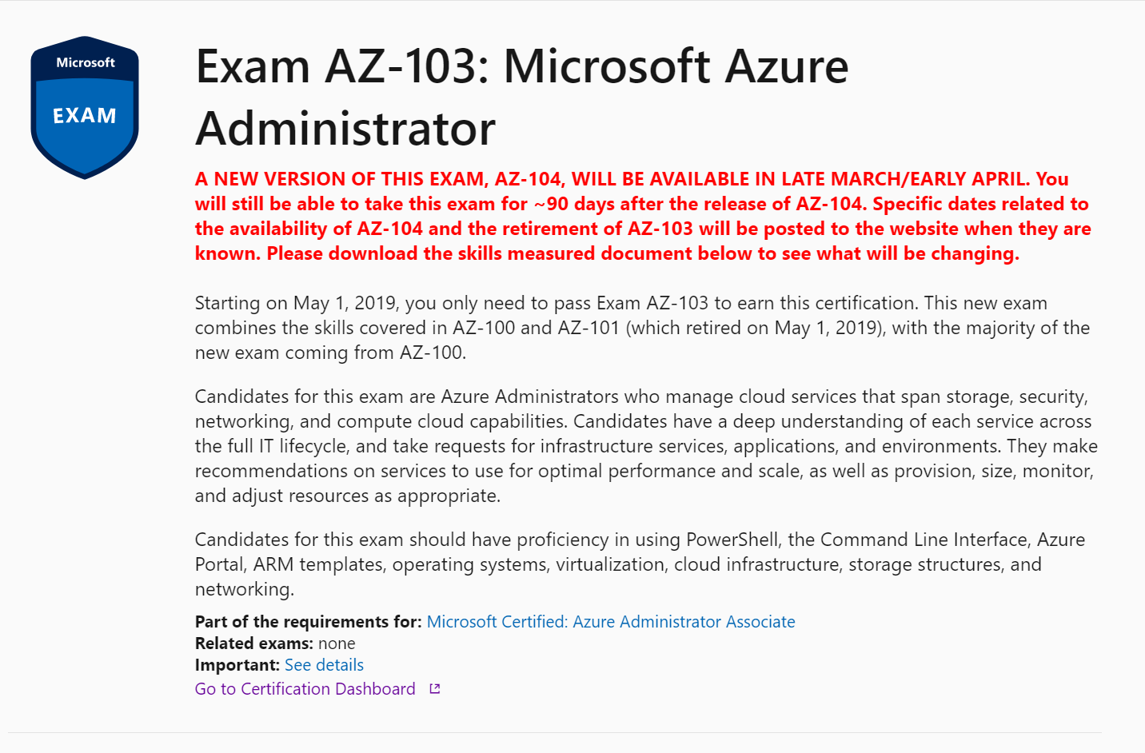
Spring 2020 Updates

Slide 14
Certification | Old Exam | New Exam | Expected Release
Microsoft Certified: Azure Administrator Associate | AZ-103 | AZ-104 | March, 2020
Microsoft Certified: Azure Developer Associate | AZ-203 | AZ-204 | February 24, 2020
Microsoft Certified: Azure Solutions Architect | AZ-300 & AZ-301 | AZ-303 & AZ-304 | March, 2020
Microsoft Certified: Azure AI Engineer Associate | AI-100 | AI-102 | March 2020
Spring 2020 Updates
More information at http://bit.ly/320n3Ak

Slide 16
Explore Microsoft Role-Based Certs
https://bit.ly/2OTlUpV
Notes:
With Microsoft's updated certifications, many are role based and designed around the in-demand job roles like Developers, Administrators, and Solutions Architect mentioned previously.
With these role-based certs, you focus on the job skills, not the technology skill per se.
Let’s take a look at the Azure Administrator Associate certification.
Starting at Microsoft Landing Page for role-based certifications, you see some of the most sought after job roles.
Let's take a look at all of the certifications.
As you can see there are a lot of certifications. Let's filter this down a bit.
For me, I'm looking for an Administrator job role on azure, and It brings up the Microsoft Certified Azure Administrator Associate.
Exploring the certification, I see
I need to pass AZ-103 for this certification
There Is an optional pre-req exam, Az-900 Azure Fundamentals,
And I need this certifcation If I want to become a certified Azure DevOps Engineer Expert
Under Skills Measured, the skills areas are broken out, very similar to what we saw with RoleIQ. This allows you to target your learning.
So how do you start prepping for to be an Azure Administrator or other Role?

Slide 17

What is VMware VCP Certification?
VMware Certified Professional
Often Deemed the “Entry Level” certification for VM Professionals
Provides a baseline level of knowledge prior to certification branches
VCA Exists underneath, but targets a different audience
Considered to be one of the most sought after virtualization certifications on the market today

Slide 18
Objective Domain

Slide 19
Training and Exam Costs

Slide 20
VMware VCP Certification Requirements
It’s more than just an exam!

Slide 21
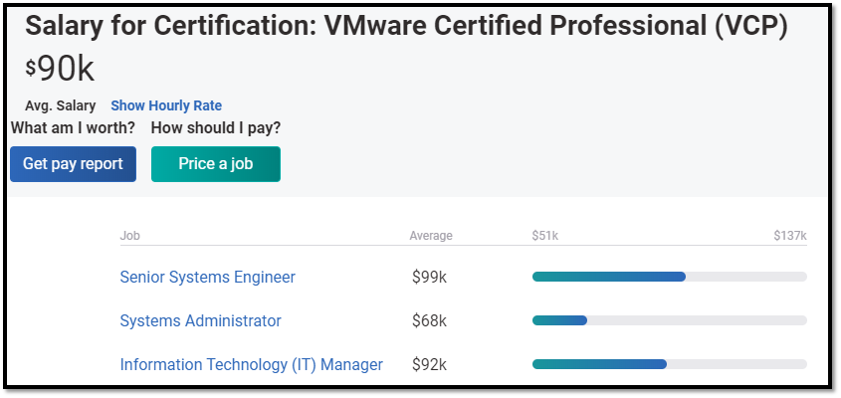
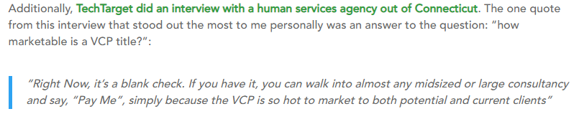
So is it worth it?
Short answer is yes! - https://www.altaro.com/vmware/certifications/
Increased Job Prospects
Increased Pay
Gives you the knowledge to reach bigger and better things
Once you have it you’re “in the club”
Recertification requirements have been relaxed, so re-cert costs are negligible

Slide 22
Getting Started with Role IQ and Azure Roles on Pluralsight
http://bit.ly/azure-ps
Notes:
To do that, I'll start at the landing page on pluralsight.com for the free Microsoft Azure Resources. The link, bit.ly/azure-ps, is in the slide deck.
You'll see the eight roles available.
I'll go into the Microsoft Azure Administrator role.
See how the role is broken into categories aligning with this specific job role. Each of these has a Skill IQ assessment available that you'll run through to see where you stand.
To do that, click Check Now, and it will bring up a registration screen.
Registration is quick, and will give you access to all of the free Microsoft Azure content for the role you choose, and the assessments.
Since I already have a pluralsight account, I'll switch over to that account.
Here you see all the roles listed again.
I'll click on Microsoft Azure Administrator, and I can begin the process for Getting my Role IQ by completing the SkillIQ assessments.
Before you start you, you see the assessment topic coverage. You have about 5 minutes to complete approximately 20 questions. I've found this varies by the SkillIQ. Don't worry if you aren't happy with the results the first time as you can do a re-do, and the low score is discarded. And you can always re-test later to see your progress upskilling.
Now let's take a look at a completed RoleIQ for Azure Security Engineer
It looks like I'm level 2, so I have some work to do.
Reviewing each skill area, I can review the personalized content for each.
From here, I'd jump into the content I need to skill up. Upon completing 60% of each section, I can measure my improvement.
And that’s RoleIQ. Isn’t that a great way to measure your skills and beginning ‘leveling up’ your career?
Transition: So maybe you aren’t ready for the full-blown Azure Administrator or Developer job roles just yet. You want to learn the foundational pieces of Azure first.

Slide 23
Getting Started with Microsoft Learn and Docs.com
Notes:
You want to learn the foundational pieces of Azure first.
No Problem!
Notice the first piece of content is a link Azure Fundamentals on Microsoft Learn. Part of docs.Microsoft.com, Microsoft Learn provides a free, online learning platform for technologists everywhere to gain knowledge and hands-on skills with Azure, Microsoft365, and other Microsoft Platforms.
With Azure Fundamentals, you learn key cloud concepts based on azure yet applicable to the broader industry cloud, get an understanding of what services are available in Azure, and learn one of the most important pieces, pricing. Without this solid foundation, it will be difficult to succeed in other job roles.
And notice that this aligns with a Microsoft Certification exam – AZ900 Microsoft Azure Fundamentals
Let’s take a look at how you can get started learning Azure Fundamentals with a free learning platform from Microsoft Learn. <Transition to demo>
Browsing through the learning path, notice it is broken up into Modules. Each module will contain a combination of written documentation, videos, hands-on exercises, and knowledge checks. As you complete modules, you’ll receive experience that is tracked by your Microsoft account.
One of the great features In learn Is a built-In sandbox where you can perform tasks hands-on for free! Yes Free! No azure trial account Is required. You need a Microsoft account.
In the Azure fundamentals learning path, let's check out the Core Cloud Services, Introduction to Azure module.
From the list, notice I have an Exercise - Create a website hosted in Azure. This exercise will walk you through creating a website In Azure using the portal.
First, I'll sign In to activate the sandbox. This process will have a few screens I need to work through to get the permissions needed set up properly.
Once completed, I'll have a sandbox that will allow me to complete this and other exercises. The sandbox has a 4hr time limit, and you can have four sandboxes a day. Important to note: Nothing persists In the sandbox, so when you come back tomorrow, none of your work Is saved, so keep that in mind.
Once complete, I browse down through the exercise directions. I'll open the Azure Portal and see what that gets us. Notice It brings us Into the azure portal using a concierge membership. This Is a policy-limited membership, and you'll be restricted to what you can create with the Resource Group assigned for you.
Sandbox access works with the Azure portal as well as with Azure Cloud Shell. Azure Cloud Shell is a browser-based CLI where you can access your azure subscription using your preferred language, Bash, or PowerShell.
Another option for more self-directed learning is Microsoft Docs, Microsoft's home for documentation. You’ll find all the information you need to begin working with Azure and other Microsoft Services in Docs. And it’s all based out of GitHub and designed to be updated regularly vs. static documentation repositories of the past like Technet. When I worked at Microsoft, I consider this our most important product as it was how our customers learned, and it was community-driven. Many of the docs are updated based on feedback from people in the community.
When I go into Azure, I see several available products.
Let’s look at Azure backup.
Once in Docs, there are many sections to choose from:
Overview is a great place to start to get to an introduction to the products.
Quickstarts are short, 5 minute demos to get you using Azure backup via all the available methods.
Tutorials are longer, scenario based demos.
And Concepts will break down all of the details of Azure Backup for deeper understanding.
I can tell you from my experience building content around Microsoft Azure, Docs.com is the first and sometimes only place I go for getting up to speed with Microsoft products.
The last thing I’ll mention is the feedback. Microsoft believes in treating ‘Documentation as Code,’ thus why it’s in GitHub. As part of that, they want you to help them make better documentation. You can send in feedback, or you can go directly to Github and submit a pull request for updates to docs. I love docs. It’s one of the Microsoft products I use every day besides Windows.
And that’s docs and learn. Two more great tools for learning!

Slide 24




Choose a
path
Acquire knowledge
Get hands-on experience
Prove your
skills
Notes:
Moving forward, you want to begin by
Exploring the different roles that are available and choose one that matches you. Whether it be one that fits with your current job or a job change, find a role that fits you, and start down the path by getting some knowledge.
Through platforms like Pluralsight, Microsoft Learn, and Microsoft Docs, there are plenty of ways to build your knowledge and skills.
Along the way, make sure you are getting hands-on with Azure so the knowledge sinks in. Remember that Microsoft Docs and Microsoft Learn both provide excellent resources for hands-on learning. And all the courses at Pluralsight are designed for you to follow along within your environment.
And since you’ve put in the work, why not give the certification a shot? In this day and age, certs will make you stand out from the crowd when matched with real-world experience.

Slide 25
Resource Slide
Role-based Certifications a Microsoft.com -> https://bit.ly/2OTlUpV
Free Azure Learning Paths at Pluralsight.com -> https://bit.ly/azure-ps
Azure Fundamentals at docs.com/learn -> https://bit.ly/azurefun
Notes:
And I have some resources for you to take with you. These are link to all the websites I covered today.
Also, make sure to download the slides and re-view the presentation on Tech Community.
And if you have questions, I’ll be outside the theatre briefly after the talk, and I’ll be in booth #1021 until 6pm tonight, and throughout the week.
O

Slide 26
Training and Exam Information

Slide 27
Learning Materials

Slide 28
How to Prep

Slide 29
Free Resources

Slide 30
Learning Materials and Resources

Slide 31
Exam Blueprints
Exam Blueprints provide:
Exam Information
Applicable Certifications
Candidate Recommendations
Topic Areas
KB References
https://www.vmware.com/education-services/certification.html

Slide 32
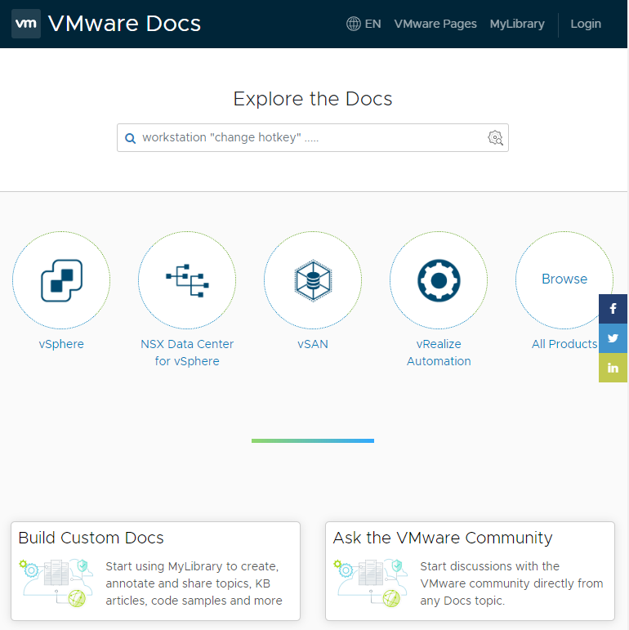
Official Documentation
Useful with Caveats
Highly Detailed
Tons of Information on All things VMware
Often too much info
Difficult to search through for specifics at times
https://docs.vmware.com

Slide 33


Other Learning Methods
Training Books
Classroom Training
Hands-On Experience
Teach what you know!
Become an Advocate of the Technology
https://dojoforums.altaro.com

Slide 34
Certification Tips and Advice

Slide 35

Tips for Exam Day

Slide 36

Be a Life Long Learner…..

Slide 37
Wrap-Up and Q & A

Slide 38
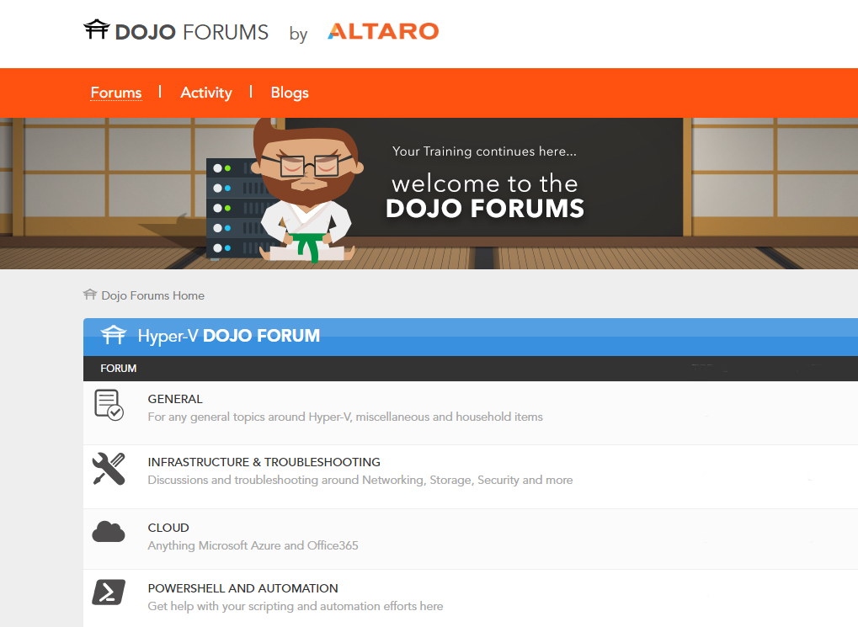
Dojo Forums by Altaro
New Forums are Live!
Hyper-V Forums are Available!
VMware and MSP Forums to Follow!
https://dojoforums.altaro.com

Slide 39
Poll & Discussion – What Certification Track is Most Appealing?

Slide 40

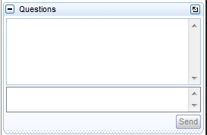
Polls, Final Q&A, and another chance for you to provide input!
Make your voice heard!
Have Questions or input of your own? Use the “Questions” box in GoToWebinar to join the conversation!
You Haz Question?

Slide 41




Get more educational content from Altaro
Thanks for Attending!
www.altaro.com/msp-dojo/
www.altaro.com/hyper-v/
www.altaro.com/vmware/
facebook.com/AltaroSoftware
@AltaroSoftware
linkedin.com/company/altaro
youtube.com/c/AltaroSoftware

